Slide 1

APR – SP – 01-H-4
IoT-Based Smart Accident Detection and Emergency Alert System
An autonomous, sensor-driven system that detects road accidents and dispatches emergency alerts in real time — no human intervention required.
Team Member 1
Team Member 2
Barathkumar K
Bhuvaneshwar AR
Team Member 3
Team Member 4
Madhankumar V
Harikrishna S

Slide 2

The Problem
Every minute counts in a road accident — yet most victims cannot call for help, and no automated system exists to trigger an emergency response.
Delayed Response
Emergency services are often notified too late, drastically reducing survival chances.
Victim Incapacitation
Injured or unconscious victims cannot make a call or send an alert on their own.
No Automation
Current systems rely entirely on bystanders or the victim — leaving a critical gap in response time.

Slide 3
Our Solution
An embedded IoT system that detects accidents autonomously and sends precise location-based alerts instantly — without any user interaction.
Auto Detection
GPS Location Fetch
Instant Alert
Sensors continuously monitor motion and detect sudden, abnormal impact patterns characteristic of a collision.
The GPS module captures precise real-time coordinates the moment an accident is detected.
An automated alert with location data is dispatched via Telegram — no button press, no delay.

Slide 4

Components Used
1
2
NodeMCU (ESP8266)
MPU6050 Sensor
Wi-Fi enabled microcontroller — the brain of the system, handling logic and network communication.
6-axis accelerometer and gyroscope for detecting sudden tilt, jerk, or impact forces.
3
4
GPS Module
LED Indicator
Provides real-time geographic coordinates for accurate emergency location reporting.
Visual feedback confirming system status — standby, detection, or alert dispatched.

Slide 5

How It Works
Sensor Monitor
Get Location
GPS obtains precise real-time coordinates
MPU6050 continuously tracks motion
Impact Detected
Send Alert
NodeMCU sends geo-tagged Telegram message
Sudden shock or abnormal tilt triggers alert
The entire detection-to-alert pipeline executes autonomously in seconds — from sensing an impact to dispatching a geo-tagged emergency message over Wi-Fi.

Slide 6
Features & Advantages
Fully Automatic
Multi-Vehicle Ready
Zero manual intervention — the system activates entirely on its own upon detecting an accident.
Compatible with bikes and cars — compact design allows easy mounting on any vehicle.
Real-Time Alerts
Low Cost & Scalable
Geo-tagged Telegram notifications are delivered within seconds of impact detection.
Built on affordable, widely available hardware — easily scalable for fleet or city-wide deployment.

Slide 7

Conclusion
A low-cost, autonomous system that bridges the critical gap between accident occurrence and emergency response — saving lives through technology.
Faster Emergency Response
Automated alerts cut notification time to near-zero, giving first responders a crucial head start.
Saves Lives
Early intervention is the single most impactful factor in accident survival rates.
Real-World Ready
Practical, deployable, and built on proven IoT hardware — ready to scale beyond the prototype.

Slide 8
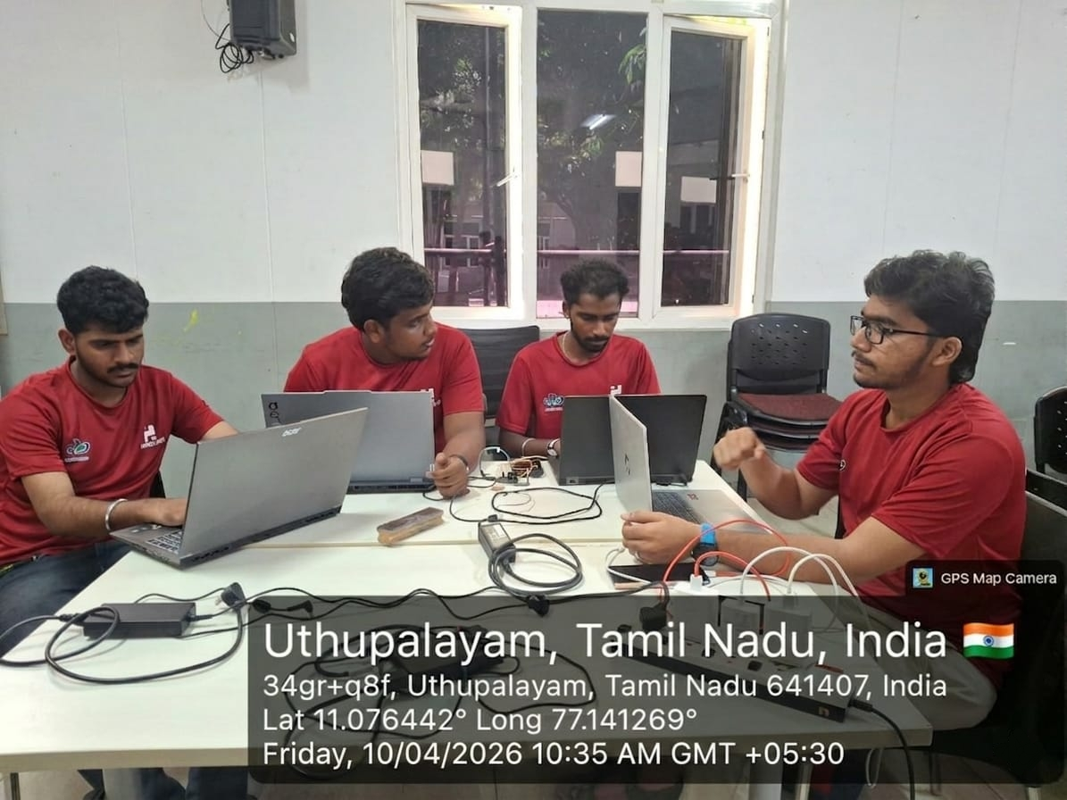



Slide 9





